Slide 1

TECH ACADEMY 2023
web security audit and prevention system

Slide 2

About me
Name: Mr. Chaichana Sereejumroenrot
Nickname: Ping
Education: 4th year bachelor's degree,
school of computer engineering,
information security major
Hobbies & Passions: coffee, window shopping
Department: Krungsri Nimble - Automation
Mentors: Mr. Surachat Boonsaen

Slide 3
01
Assignment Overview
Agenda
02
Internship journey
03
Success story
04
I like and I wish

Slide 4
Part1
Assignment Overview

Slide 5
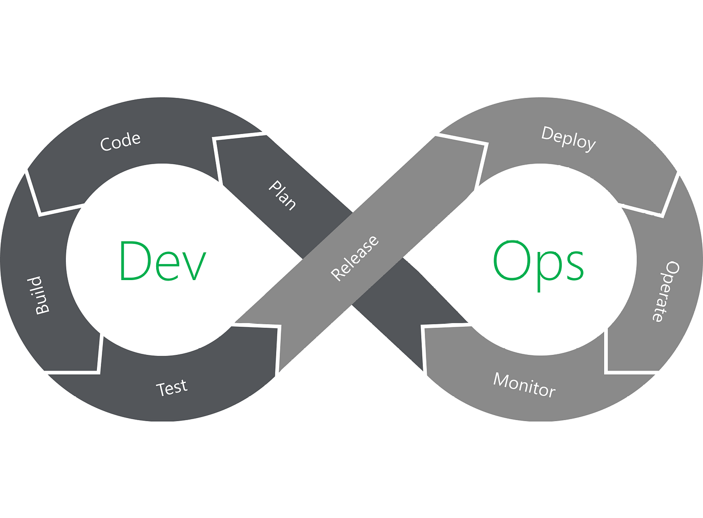
Assignment Overview
02
03
04
1. What is DevOps?

Slide 6

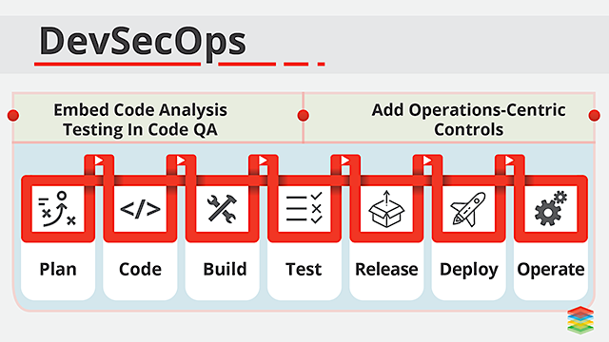
Assignment Overview
02
03
04
it should be
“DevSecOps is not a position,
It’s a culture.”

Slide 7

Assignment Overview
02
03
04
2. Web vulnerability scanner project
Web vulnerability scanner is software application that assesses security vulnerabilities in product or host systems and produces a set of scan results.
Benefits, web vulnerability scanner allows early detection and handling of known security problems. Its’ more economical and accessible than penetration testing.

Slide 8
Assignment Overview
02
03
04
Static analysis
Web vulnerabilities static analysis is a technique used to detect security flaws and weaknesses in web applications by analyzing their source code, configuration files, and other static artifacts.
Lexical Analysis converts source code syntax into ‘tokens’ of information into an attempt to abstract the source code and make it easier to manipulate
Classification: CWE-89, Improper Neutralization of Special Elements used in an SQL Command
Source file: /hj/var/www/artists.php, line: 61
Additional detail: "mysql_query" was called.

Slide 9
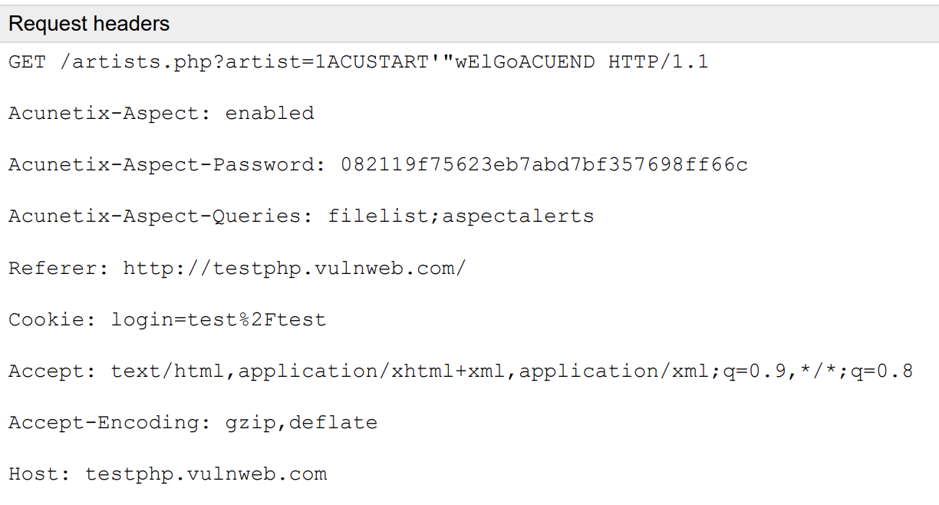
Assignment Overview
02
03
04
Dynamic analysis
in the context of software development, is a technique for analyzing software applications while they are running.
Response
SQL query, SELECT * FROM x WHERE y=1ACUSTART'"wElGoACUEND
Additional detail: “mysql_query” was called.

Slide 10
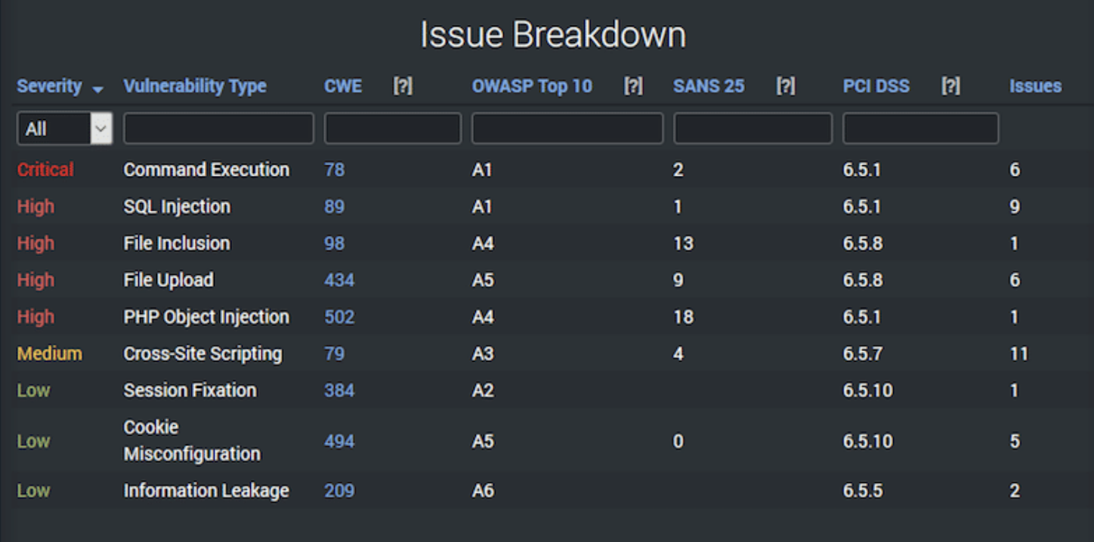
Assignment Overview
02
03
04
Produces a set of scan result

Slide 11

Assignment Overview
02
03
04
3. CI/CD with ultimate tool

Slide 12
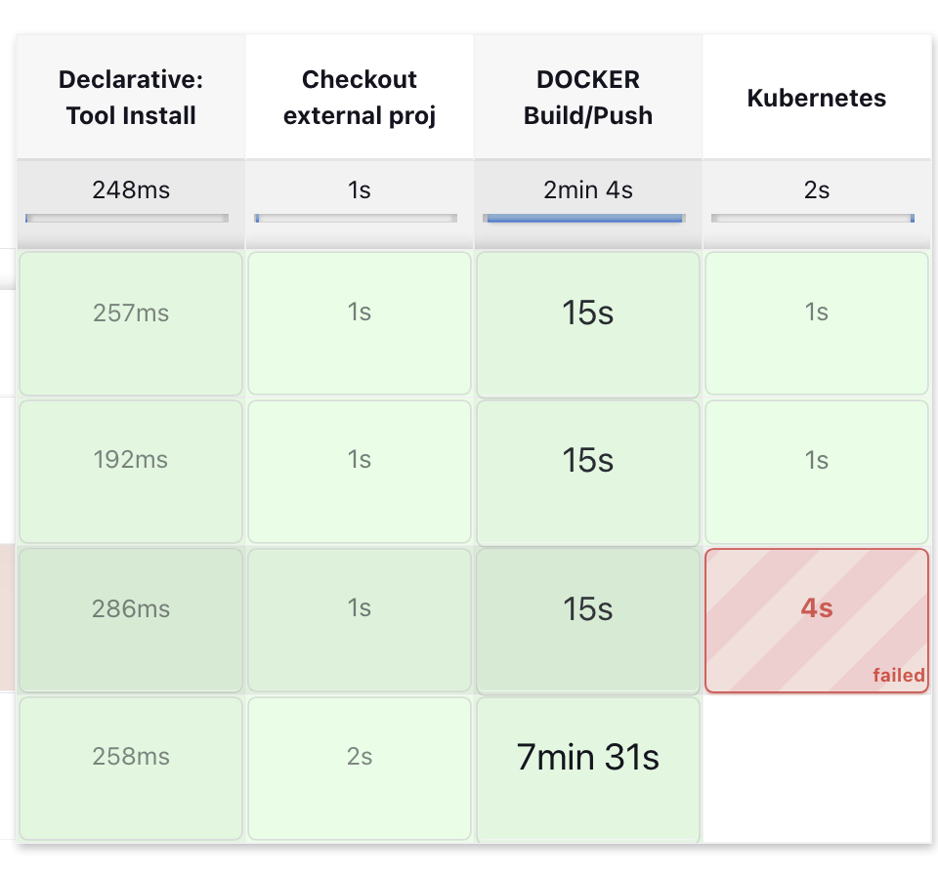
Assignment Overview
02
03
04
CI & CD Pipeline
This CI & CD involves various tools and steps which needs to be automated and the result is often termed as CI&CD Automation Pipeline, reason these steps are interlinked with each other and each step must be performed after success of previous steps.

Slide 13
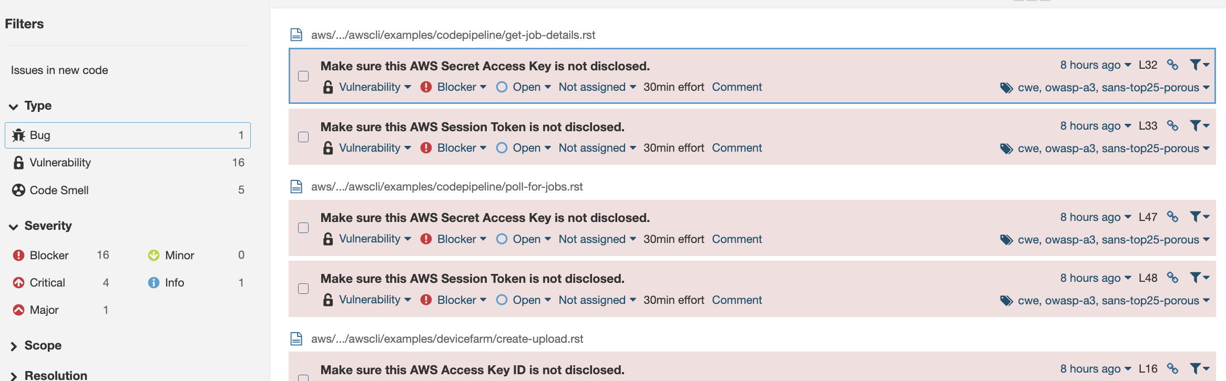
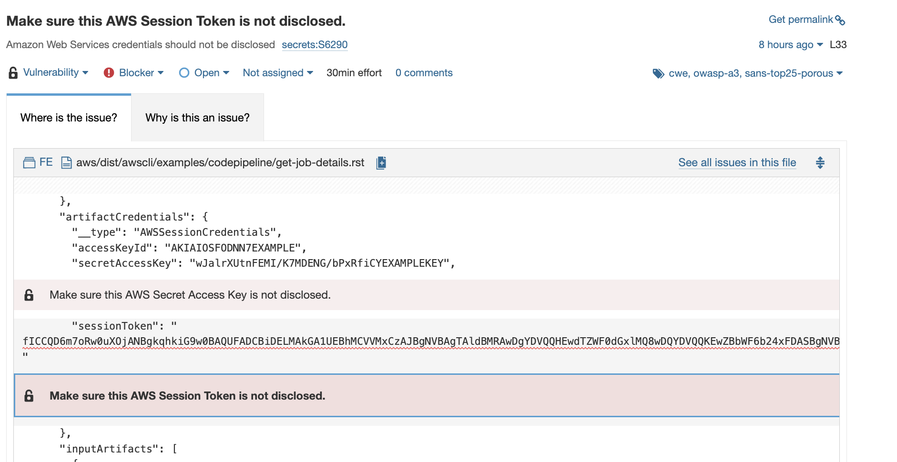
Assignment Overview
02
03
04
Checkout code and validation

Slide 14
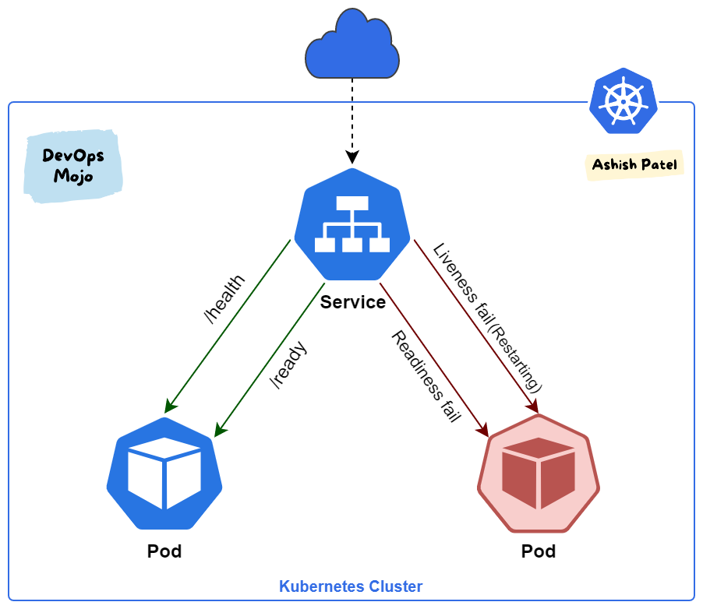

Assignment Overview
02
03
04
Serving Kubernetes products

Slide 15
Part2
Internship journey

Slide 16




01
Internship journey
02
04
1. Evolution

Slide 17
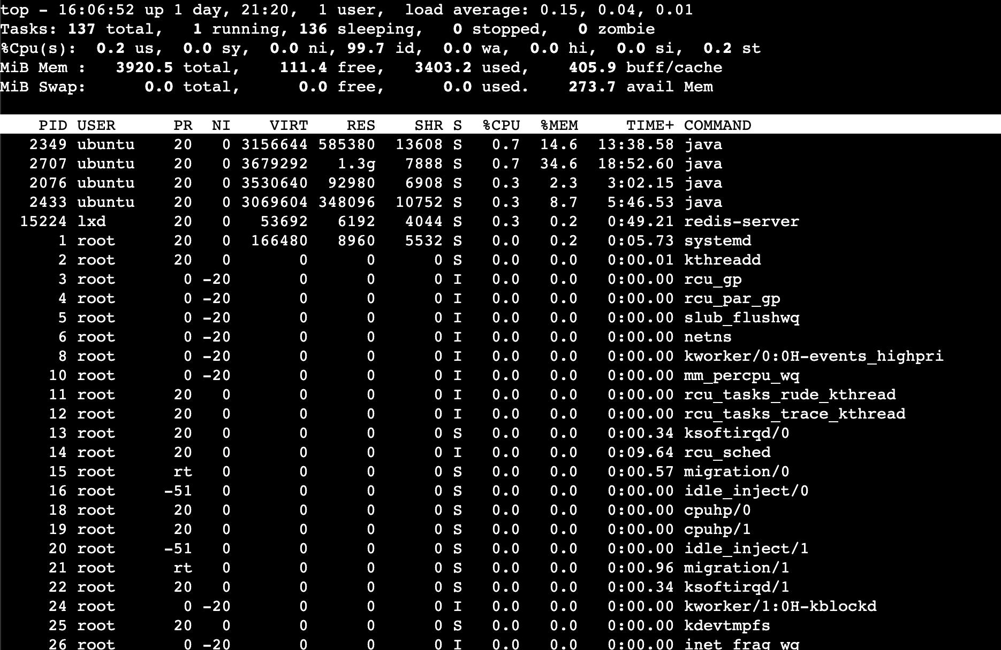
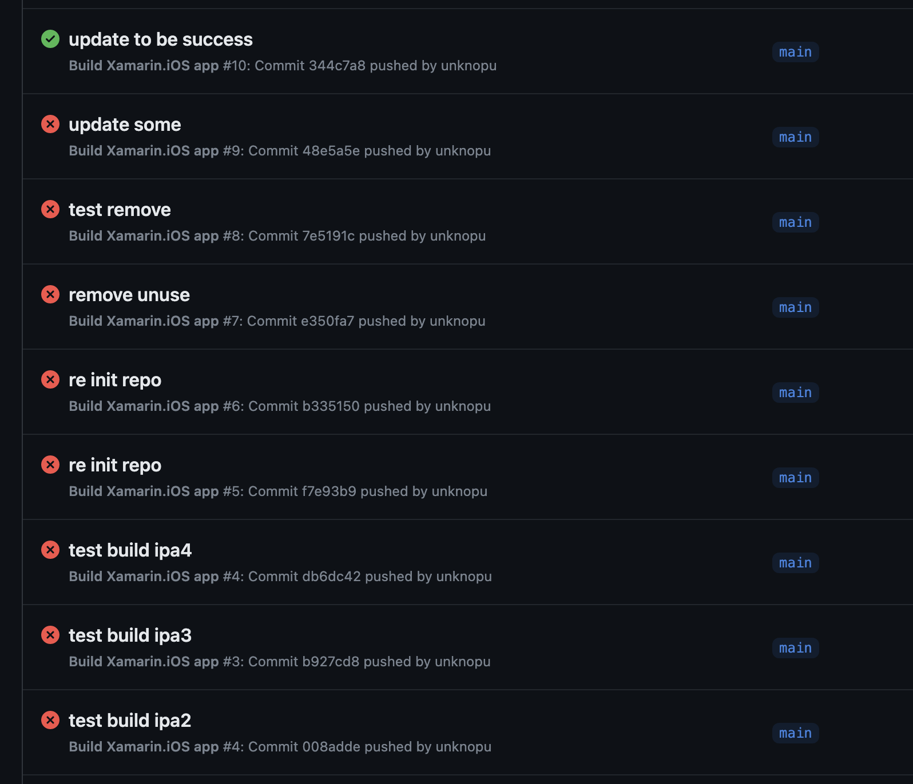
01
Internship journey
02
04
2. Problem solving

Slide 18
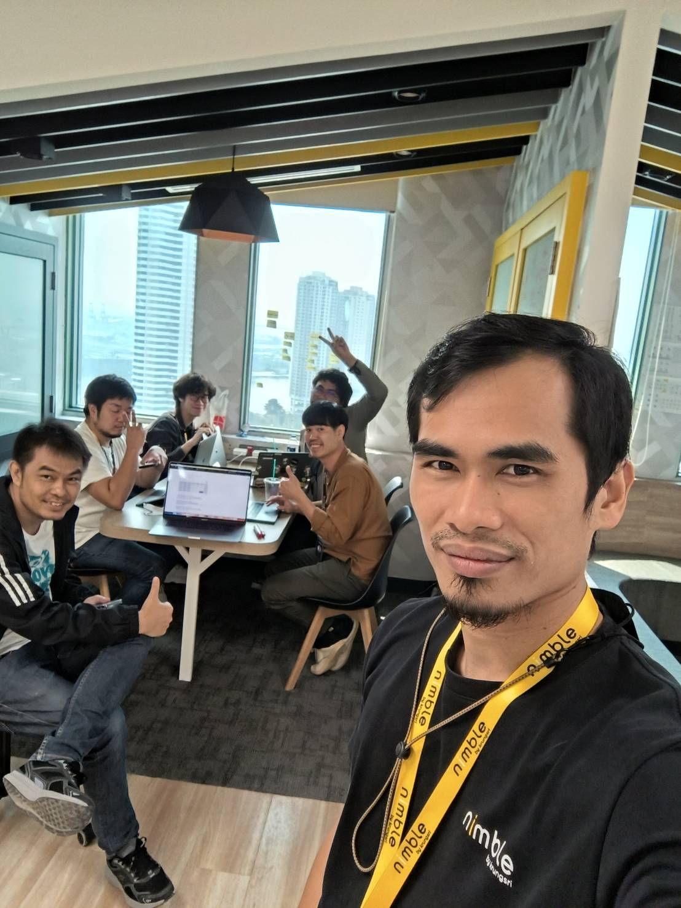
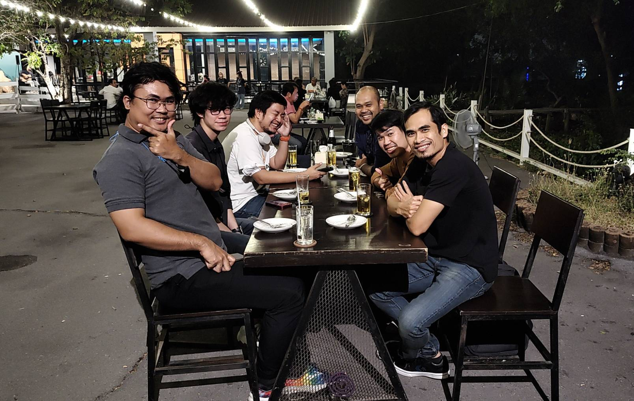
01
Internship journey
02
04
3. Working environment & teamate

Slide 19
Part3
Success story

Slide 20



01
02
Success story
04
1. Concept and Implementation

Slide 21
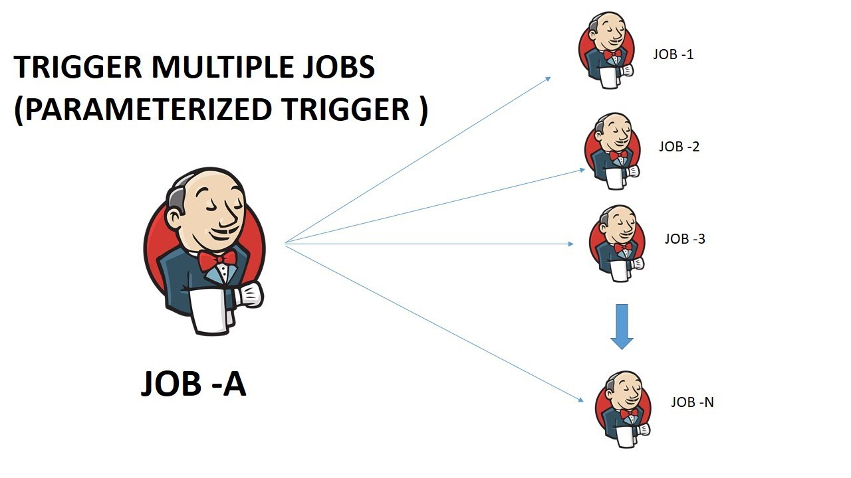
01
02
Success story
04
Power up Jenkins

Slide 22

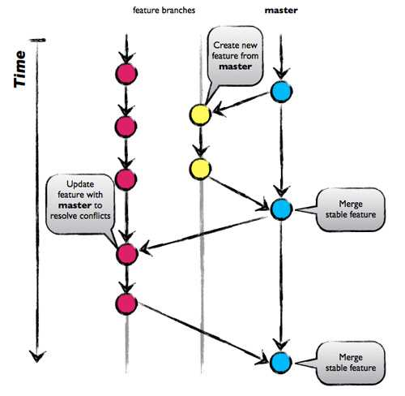
01
02
Success story
04
Git strategy

Slide 23
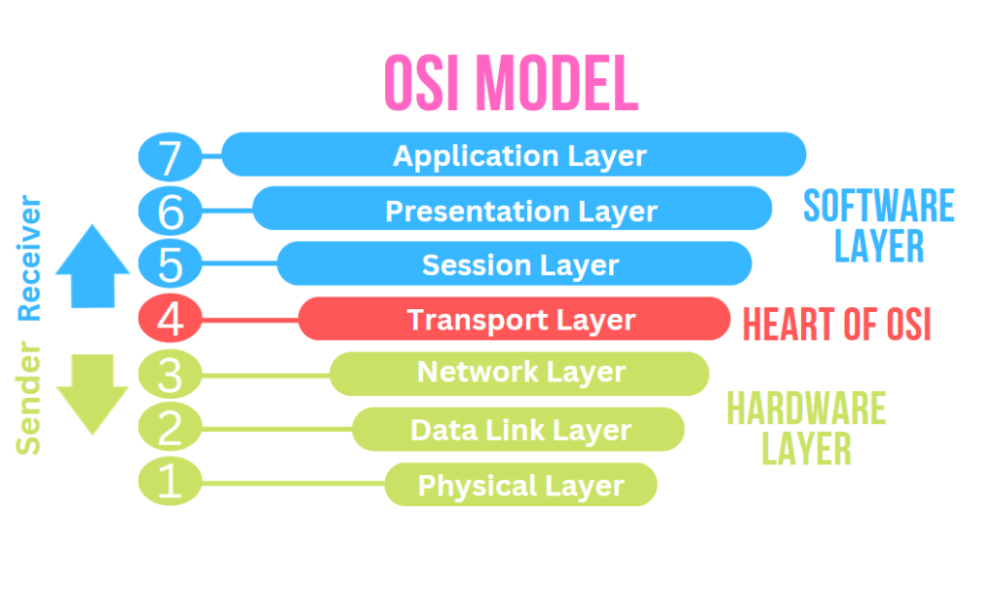
01
02
Success story
04
Real world Layers of OSI Model

Slide 24
Part4
I like and I wish

Slide 25
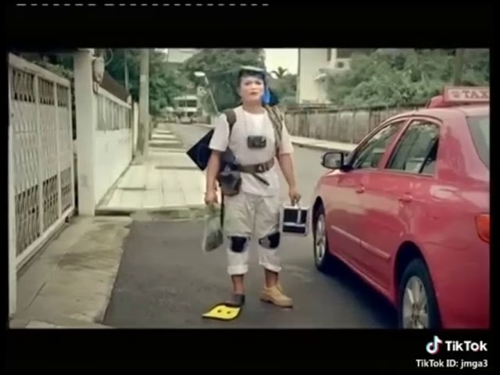
01
02
03
I like and I wish
Various activities

Slide 26

01
02
03
I like and I wish
supportation

Slide 27

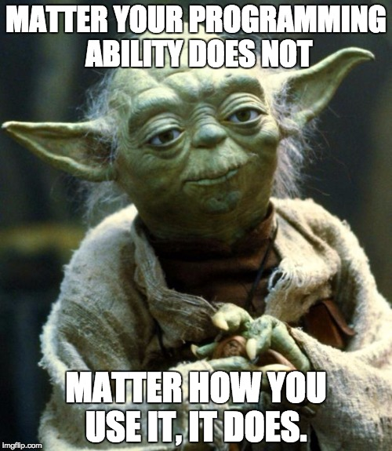
01
02
03
I like and I wish
experienced

